Slide 1

Cloud API development guide
Part 3
Develop a Java application by using global weather online API
V1.0
Author: Sheng deng/China/IBM
Feb 2014
© 2014 IBM Corporation

Slide 2
Agenda
1. Introduction of Part 3 of the development guide
2. To understand Cloud API
3. To Create a weather API application by using global weather online API
4. Publish your application on BlueMix and verify the result.

Slide 3
1. Introduction of Part 3 of the development guide
Objective
The China GDC AIS Cloud API & BlueMix development guide is a serials development guide to setup a hands on/step by step guide for helping developer within IBM use Eclipse Kepler for building application through BlueMix cloud platform.
The document is part 3 of the serials development guide.
Dependency
Before you start part 3 guide, please ensure you have finished the part 1 and part 2 guide through the linkage below:
https://w3-connections.ibm.com/communities/service/html/communitystart?communityUuid=ee2ef5b2-f52b-424a-b955-cf34d41156a3
Get support
If you are China GDC employee, please kindly join the China GDC AIS Cloud API community, the community will launch the latest development guide and recommended trainings to shift your capability from tradtional development skill to cloud based API design/development skill.
If you have any issues/questions, you can raise questions from the community, then our SME will try to answer your questions in the community.
For joining China GDC AIS Cloud API Blue community, please click the linkage below.
https://w3-connections.ibm.com/communities/service/html/communitystart?communityUuid=ee2ef5b2-f52b-424a-b955-cf34d41156a3
Note: your BlueMix API access URL shall be:
https://ace. stage1.ng.bluemix.net

Slide 4
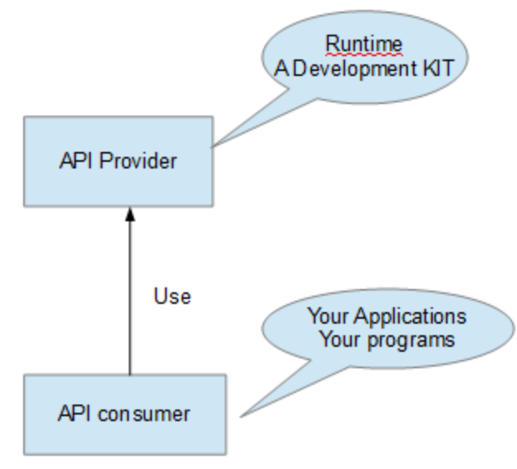
2. To understand Gloud API
(1). What is API
API is a programming interface, generally it should have an API provider, which provides many interfaces to allow API consumer to access/utilize the interfaces provided by API provider. ie. Java API, Java development KIT provides many application interfaces, Java application/program can be consumer of those APIs. The application/program invoke/utilize the interfaces provided by Java development KIT.

Slide 5
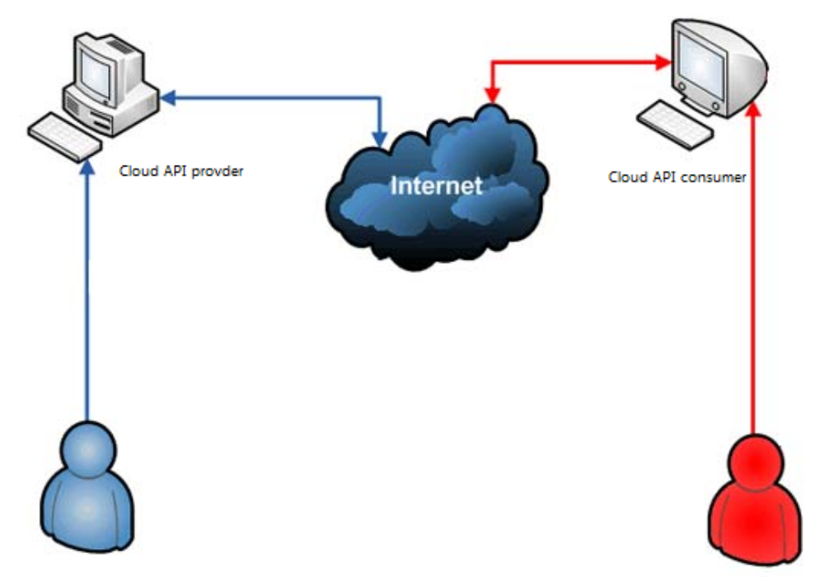
2. To understand Gloud API
(2). What is Cloud API
Cloud API provider is a cloud platform/internet API provider, generally the provider provides the application
Interface by using restful way, which can utilize HTTP protocal and directly invoked via a HTTP request.

Slide 6
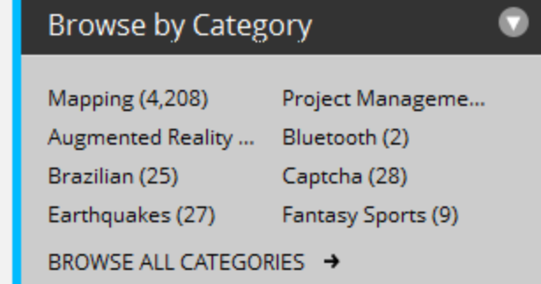
2. To understand Gloud API
(3). Where can I get cloud API?
There are plenty of Cloud APIs available on programable web, refer to the URL below:
http://www.programmableweb.com/
There are many categories of cloud API ready on programable web:
You can click the browser by category for checking cloud API categories from the website, as you can see there are many public API focusing on MAP, sports and project management ... relevant areas.
If you want to lean more about cloud API, you can deep dive the website and find your interested part for further investigation/study.

Slide 7
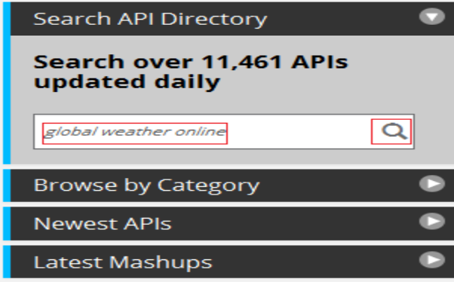
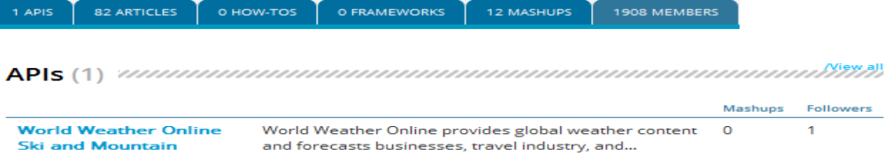
3. To Create a weather API application by using global weather online API
(1). I am going to show you:
- How to create a weather API application by using the global online weather API
- Deploy it on the local Liberty environment for debugging and local test purpose
- Publish your app on BlueMix and verify the application.
(2). Locate the weather API from programable web:
Input the search text as 'global weather online', then click the search icon from the search area of the website.
Then you can see the website search result for 1 API as following:

Slide 8
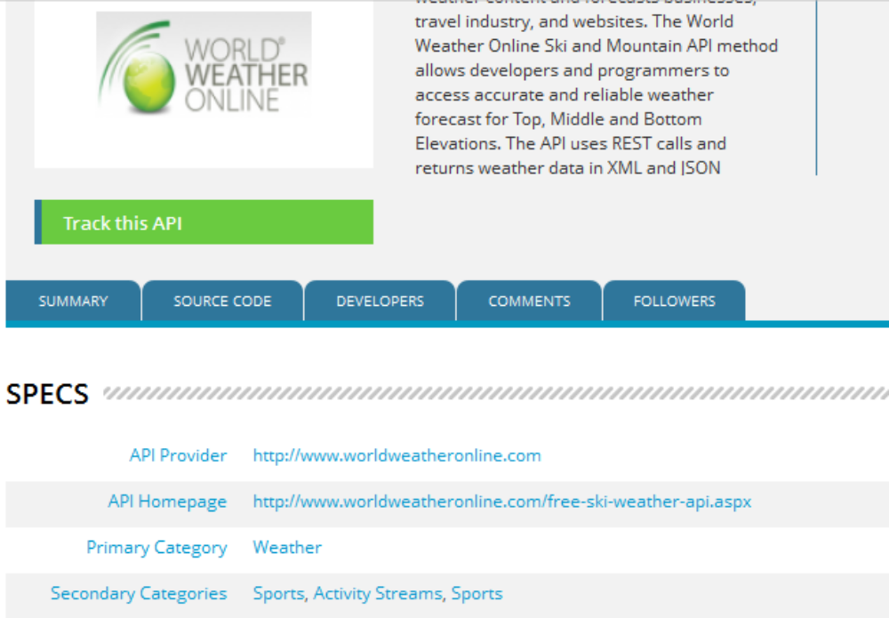
3. To Create a weather API application by using global weather online API
Click the linkage 'world weather online ski and Mountain', then you can see the screen as following:
Click the linkage http://www.worldweatheronline.com/free-ski-weather-api.aspx
Then you should be redirected to the gloabl online weather API website.

Slide 9
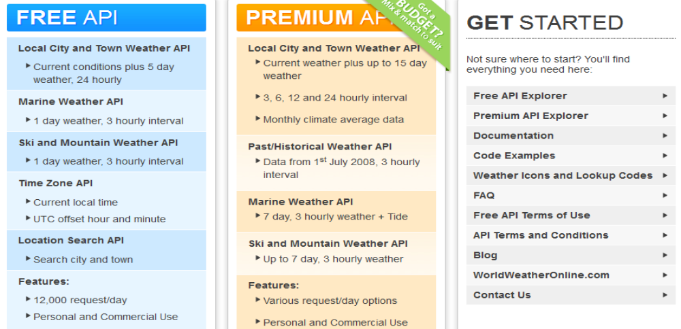
3. To Create a weather API application by using global weather online API
There are 3 types API provided by the website, you can select the free API, when you are registering as API
developer on the website.

Slide 10
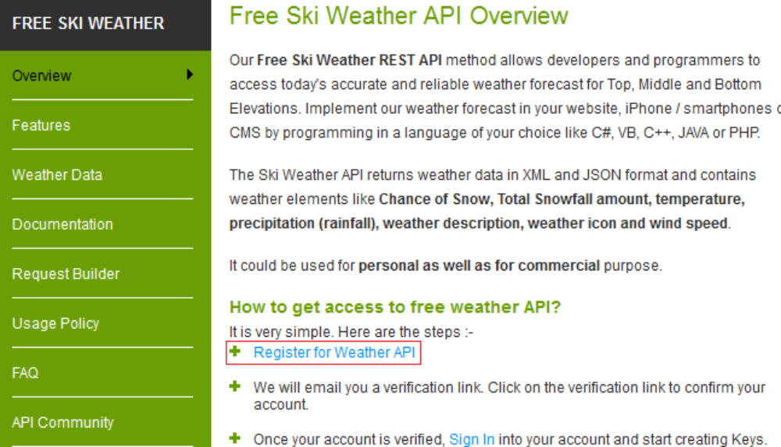
3. To Create a weather API application by using global weather online API
(3). Register as an API developer from the website
Please follow up the register process from the website for finishing the regsitration process, suggest you can use
a your public email like xxx@gmail.com.cn/xxx@163.com.cn for registration as an API developer.
When you finish the registration you can sign in the website and create API keys, through which you can
leverage the key by restful way to access the API interfaces.

Slide 11
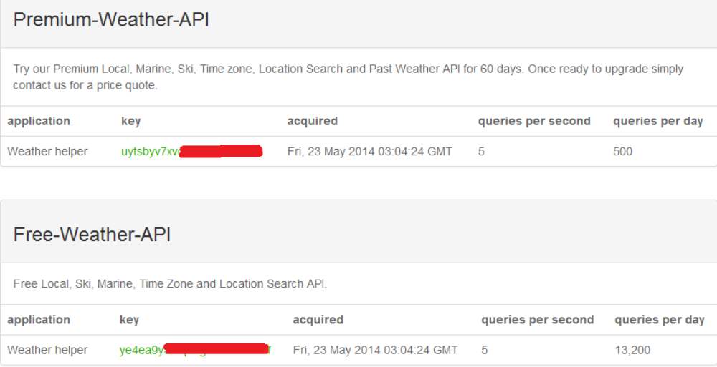
3. To Create a weather API application by using global weather online API
Your Keys screen: You can use the free weather API key in your application to access the weather API after registration.

Slide 12
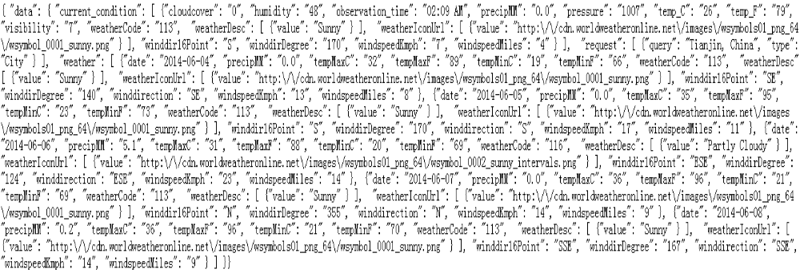
3. To Create a weather API application by using global weather online API
(4). Quick test by using your key to access the API
I think so far you have gotten the key for accessing the API, please input your access URL from browser, ie, Firefox/IE.
http://api.worldweatheronline.com/free/v1/weather.ashx?q=TianJin&format=json&num_of_days=5&key=ye4ea9y5vxxxxxxxxxxxxxxxxx
Note: You should replace the key from the above URL with your key, through the above URL you can search 5 days weather information for TianJin city to you. The result is formatted by Json.
If you need to learn more about Json, you can refer to the URL below:
https://w3-connections.ibm.com/wikis/home?lang=zh-cn#!/wiki/W761a7cd6952b_43ff_920f_b412cd0157f4/page/JavaScript%20Object%20Notation

Slide 13
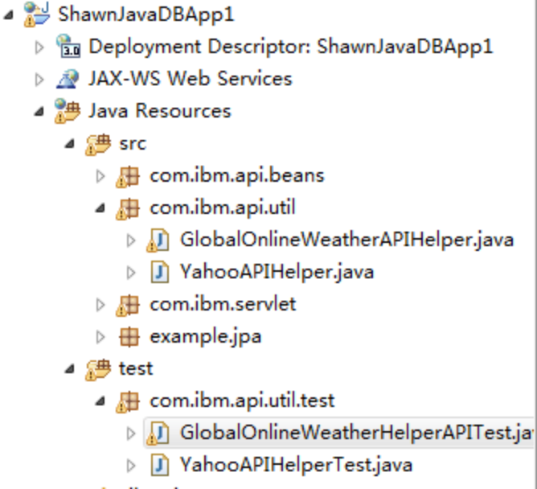
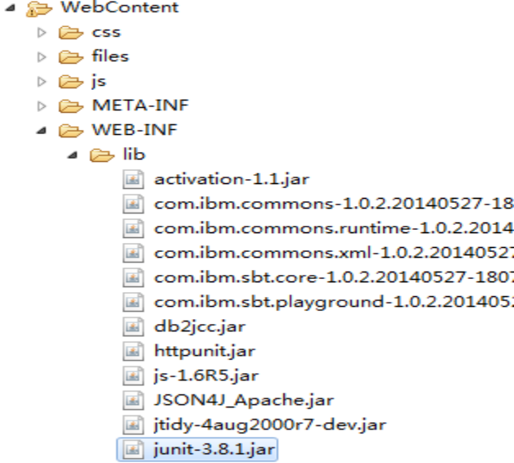
3. To Create a weather API application by using global weather online API
(5). Create development code in the project
GlobalOnlineWeatherAPIHelper.java under the package com.ibm.api.util from your own application which should be created already per guide 1&2.
Before start programming, you need to import the JSON4J_Apache.jar, httpunit.jar, junit-3.8.1.jar into your package: WebContent/WEB-INF/lib. Kindly find those jar files through internet.

Slide 14
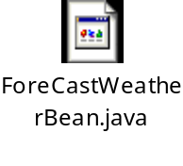
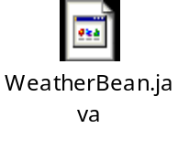

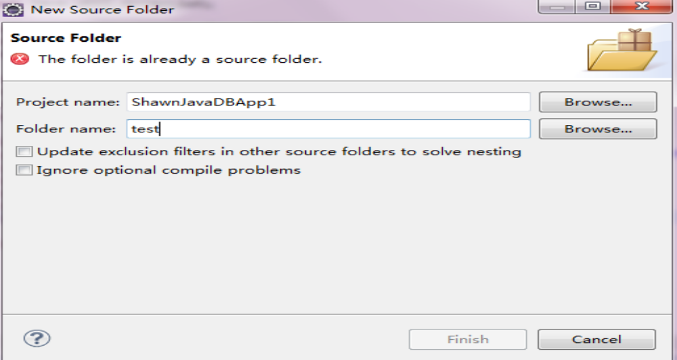
3. To Create a weather API application by using global weather online API
Create ForeCastWeatherBean.java and WeatherBean.java under the package com.ibm.api.beans.
The source code for the 3 java classes:
If you want to make the application runs fine, please well upate the code from GlobalOnlineWeatherAPIHelper.API_KEY to set your personal API key in the code.
(6). Create test case class
Then create Junit test case and put it under another source code directory: test.
a. Right clik your application folder, then click 'new', from the coming popup window, select the application as your application. Input your source folder name as test, then click Finish button.

Slide 15
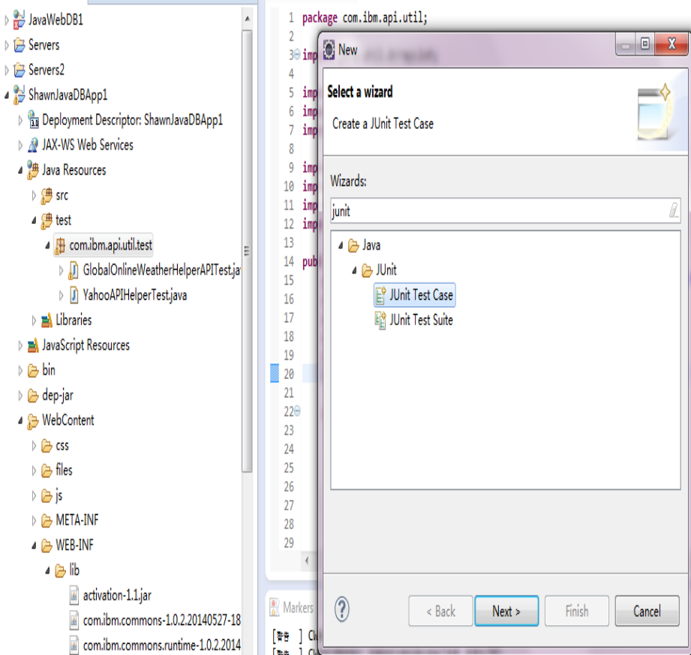
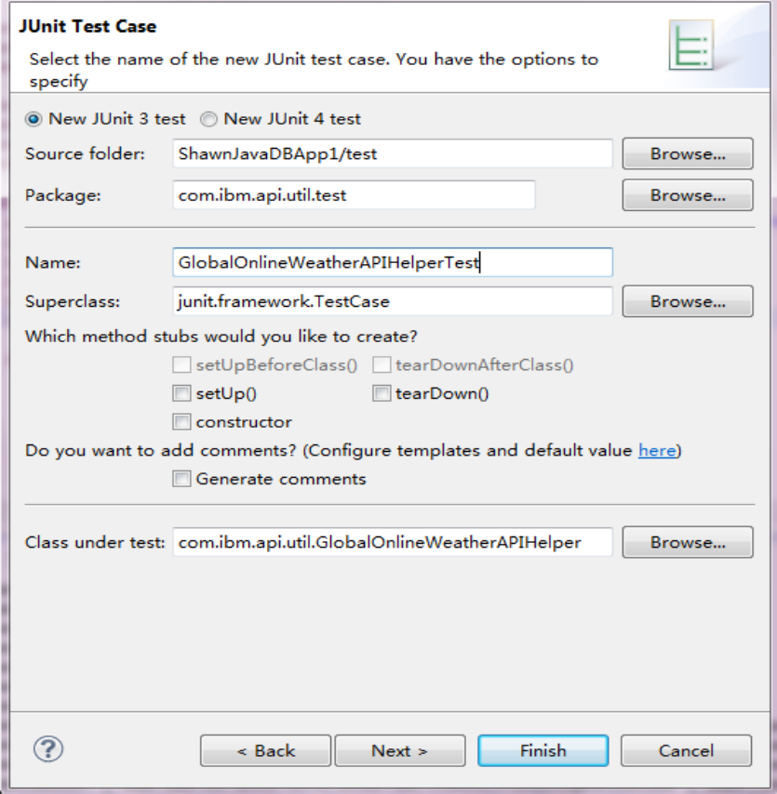
3. To Create a weather API application by using global weather online API
b. Select the test source folder and right click create new package 'com.ibm.api.util.test'.
c. Then create a Junit test case and click the Next button for continue.
d. Select the under test class 'GlobalOnlineWeatherAPIHelper' which you just created, input the class name as
GlobalOnlineWeatherAPIHelperTest, then click 'Finish' button for generating the Junit test case.

Slide 16

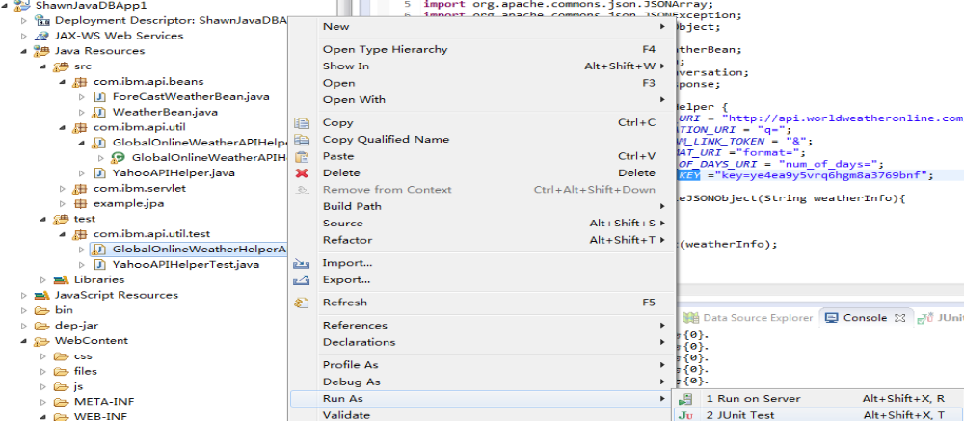
3. To Create a weather API application by using global weather online API
e. Refer to the test code and execute the test case.
Select the test case, then right click from 'Run as' menu to select 'Junit test', after that Eclipse Kepler would run
your test cases, or you can use 'Alt + Shift + X,T' for executing the test case directly.

Slide 17
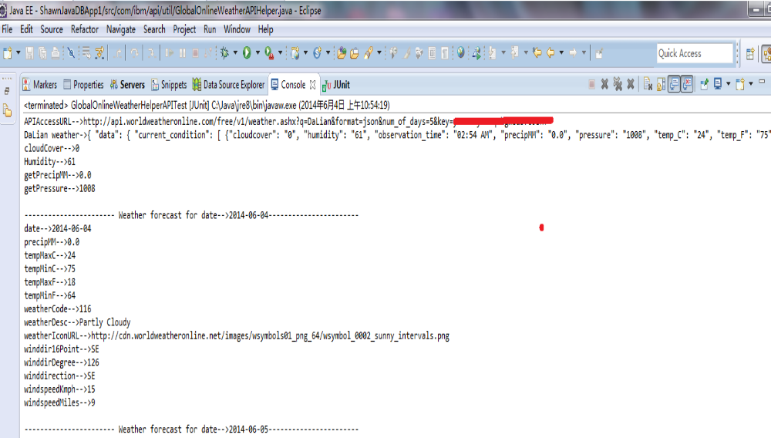
3. To Create a weather API application by using global weather online API
You can see the test result as following, which means the you can invoke the API successfully through the Junit test case.

Slide 18
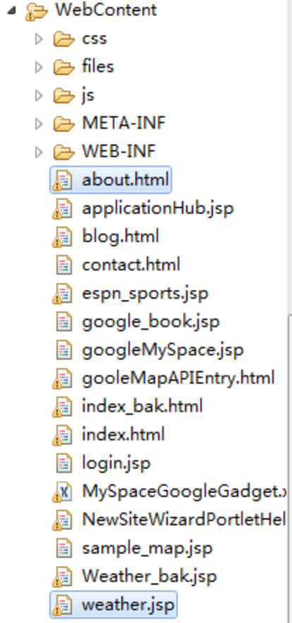
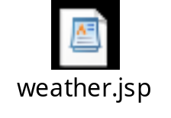
3. To Create a weather API application by using global weather online API
(7). Create a weather jsp under the WebContent directory, you can refer to the source code as following:

Slide 19
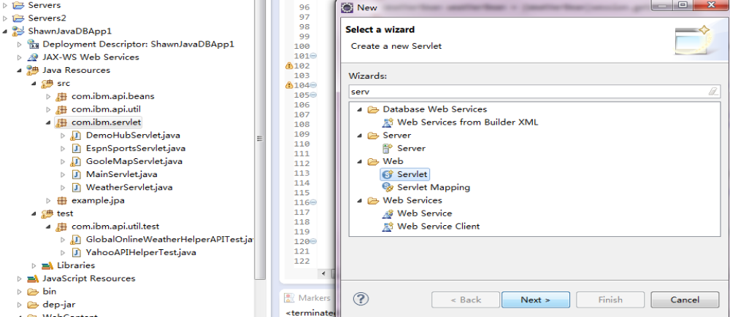
3. To Create a weather API application by using global weather online API
(8). Create a servlet for handling request and response the weather.jsp actions
- Create a package 'com.ibm.servlet' under the Java resources/src directory
- Create a servlet class through right clicking the package and create a new servlet.
- Click the Next button for continue.
- From the next screen, input the class name as 'WeatherServlet', then click finish button.

Slide 20
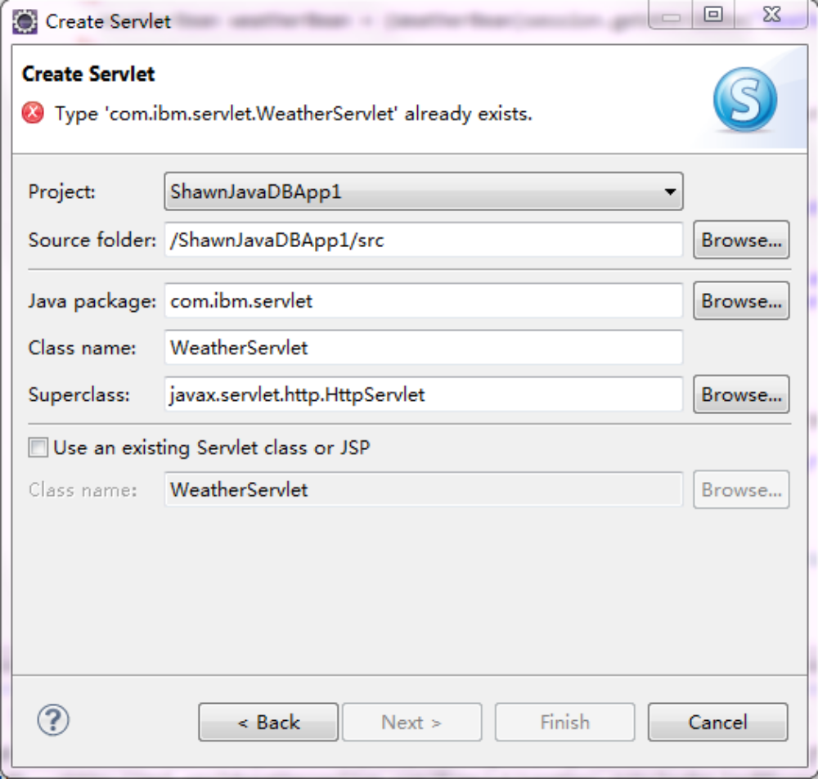

3. To Create a weather API application by using global weather online API
- Refer to the screen below and source code.

Slide 21
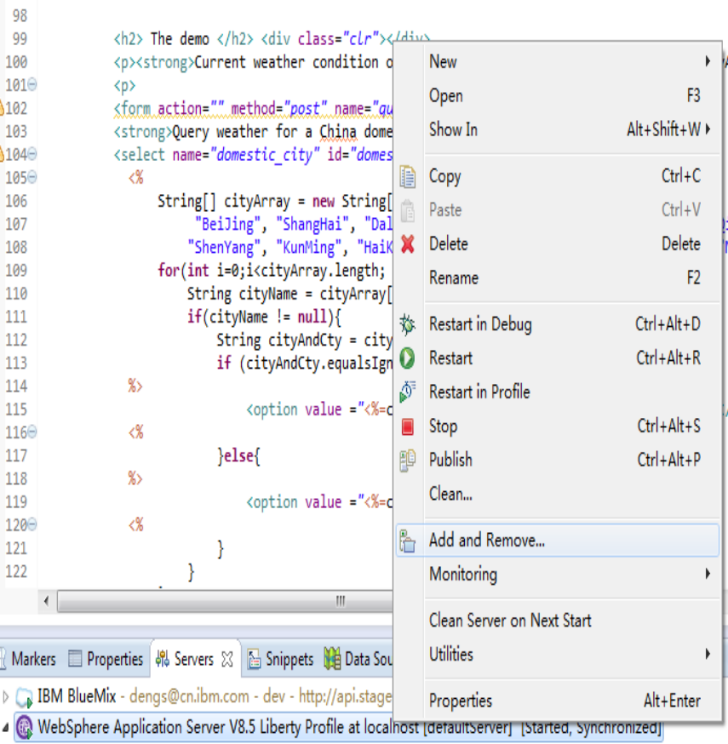
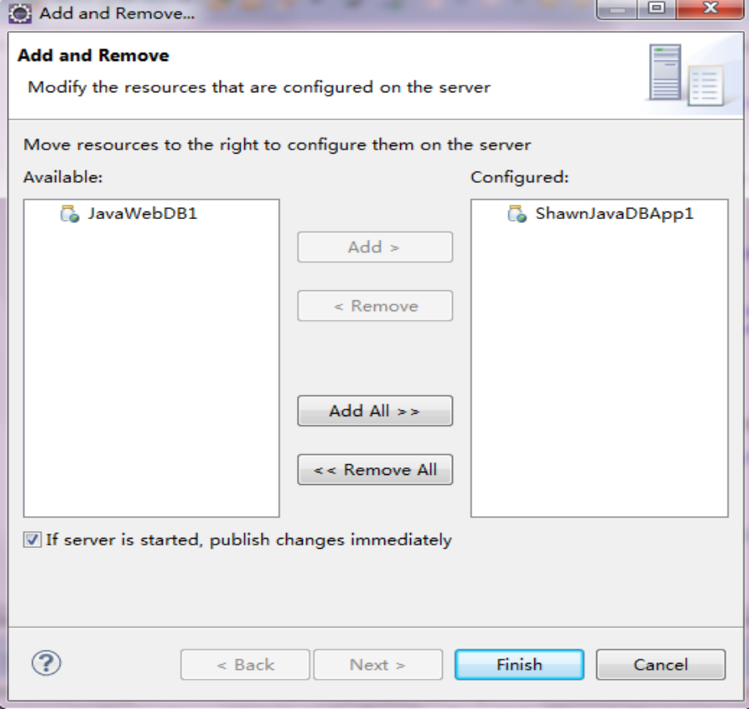
3. To Create a weather API application by using global weather online API
(9). Test the application from your Liberty environment.
- Suppose your project has been added to the liberty server through 'Add and Remove' function, refer to below
2 screens for verification, then please click the 'Finish' button.

Slide 22
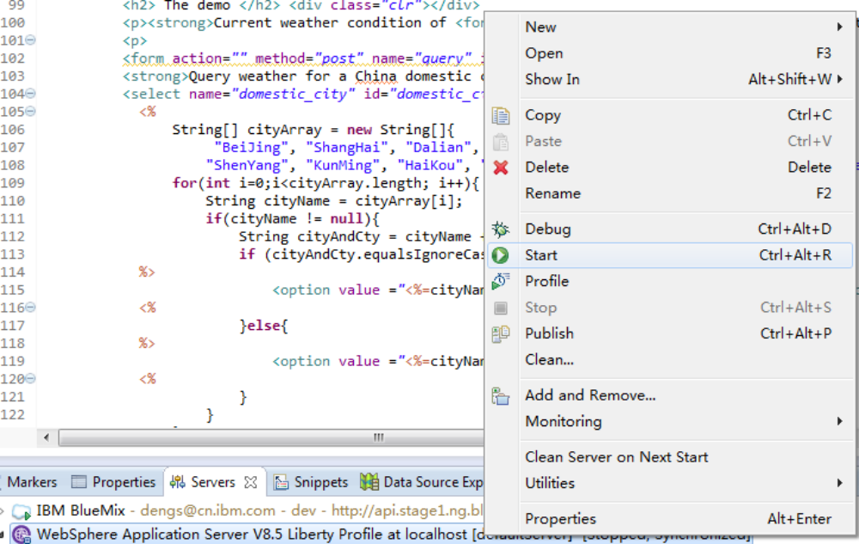
3. To Create a weather API application by using global weather online API
- Right click the 'Start' button from the servers view, before that please ensure you selected WebSphere
Application Server v8.5 Liberty.

Slide 23
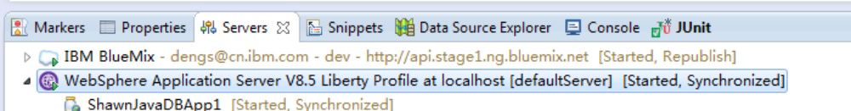
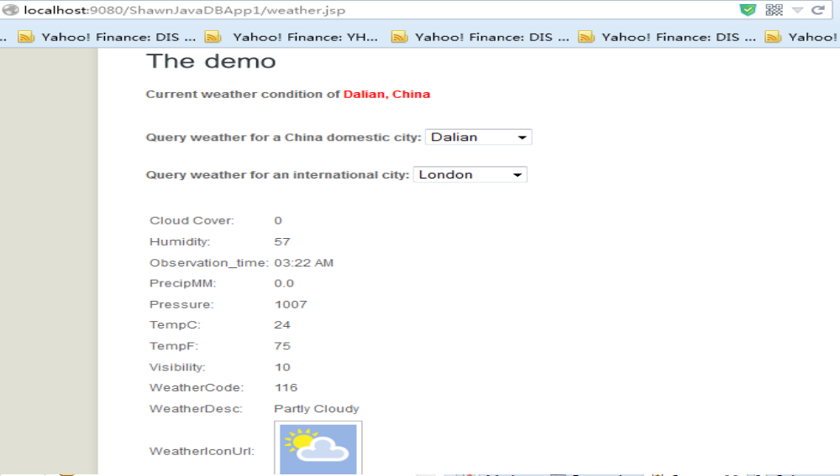
3. To Create a weather API application by using global weather online API
- Then wait less than a min, you can see the server started, if you are lucky. :_)
- Input your weather.jsp access URL from browser as following:
http://localhost:9080/<yourAppName>/weather.jsp
Note: You need to replace <yourAppName> with the application name your own, before the test starts.
- If you can see below screen. Congratulations! You have successfully adopted a global weath online API in
an application. You can switch international city/demostic city through selecting the city list to check weather.

Slide 24
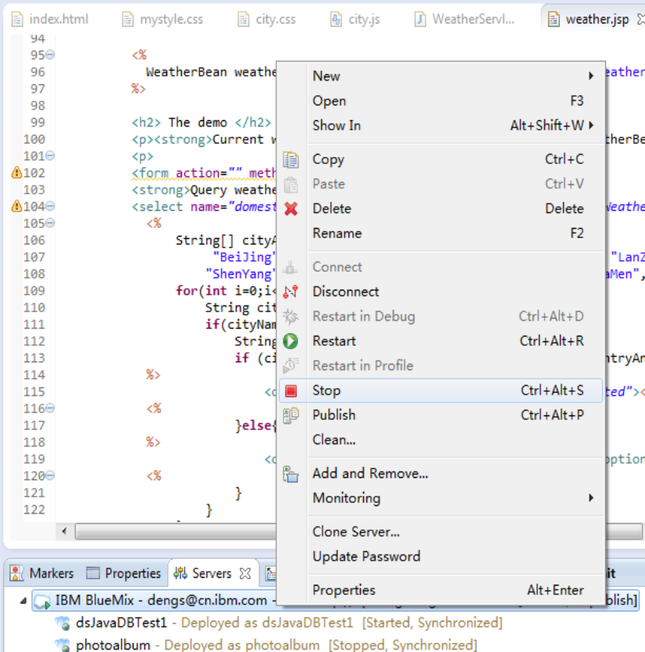
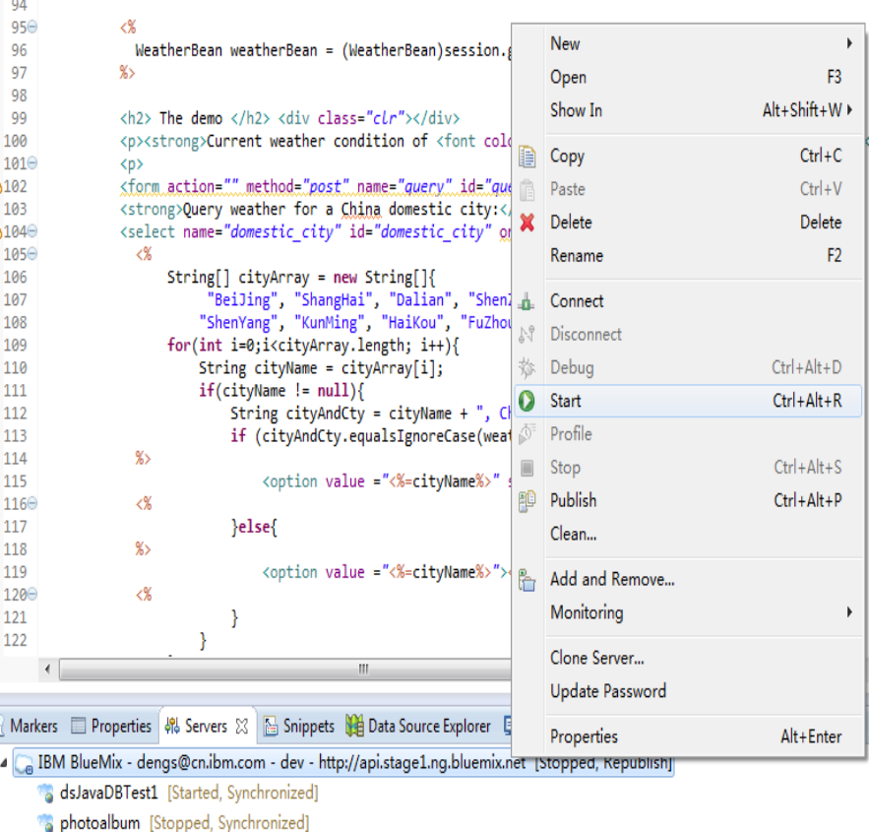
4. Push your application on BlueMix and verify the result.
- We have just finished the local test to verify the result on of local development Liberty environment, let us
carry on.
- Suppose you have done the guide 1 and 2, if you do so your local IDE(Eclipse Kepler has been well linked in
BlueMix), so what we just need to restart our BlueMix instance from the BlueMix server console of our Eclipse
Keper. Select the BlueMix server instance, click the Stop from menu. Then select BlueMix server instance
again, then click 'Start' from the menu.

Slide 25
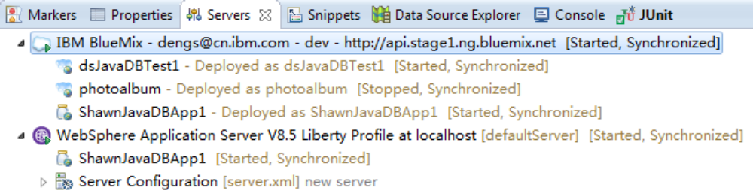
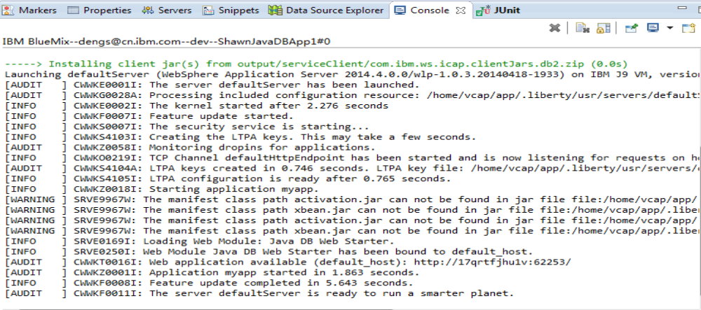
4. Push your application on BlueMix and verify the result.
After your BlueMix server restarted, you can see the screen as following from server view.
And also you can find the logs from console view of BlueMix server isntance, which means your BlueMix
server instance has been well restarted on BlueMix cloud platform.

Slide 26
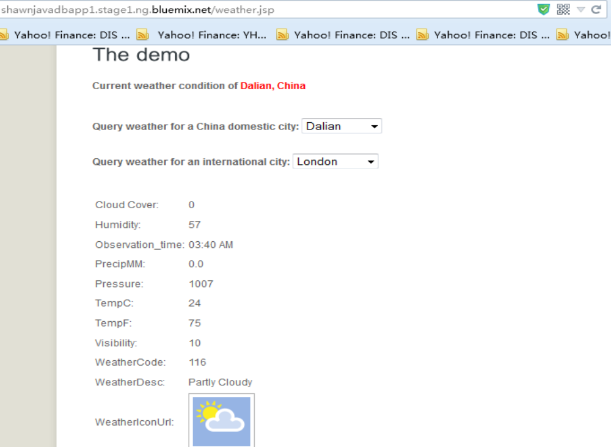
4. Push your application on BlueMix and verify the result.
You can see the demo dispalying on your BlueMix website as well from the URL:
http://<yourAppName>.stage1.ng.bluemix.net/weather.jsp
This is about end of the part 3, for more information, please refer to China GDC AIS Cloud API community.
https://w3-connections.ibm.com/communities/service/html/communitystart?communityUuid=ee2ef5b2-f52b-
424a-b955-cf34d41156a3

